Slide 1
Project One Investment Portfolio
Joeny Vo

Slide 2
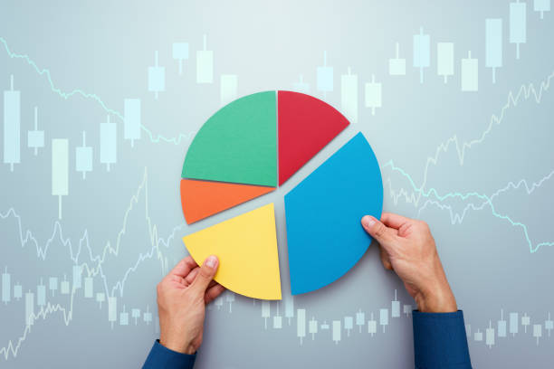
Portfolio Overview
Initial Investment
$100,000
Portfolio Duration
1 year
July 1st, 2023 - June 30th , 2024
Diversification
3 Stocks
1 Exchange-Traded Fund
1 Forex

Slide 3




Investment Selection
Stocks
Nvidia
Amazon
JPMorgan
ETF
SPDR S&P 500 ETF Trust (SPY)
Forex
USD/CAD

Slide 4
Investment Strategy
Initial Investment - $100,000
60% - Stocks
30% - ETF
10% - Forex
Additional investment of $4,000
Every 4 months
Based on analysis of time span

Slide 5
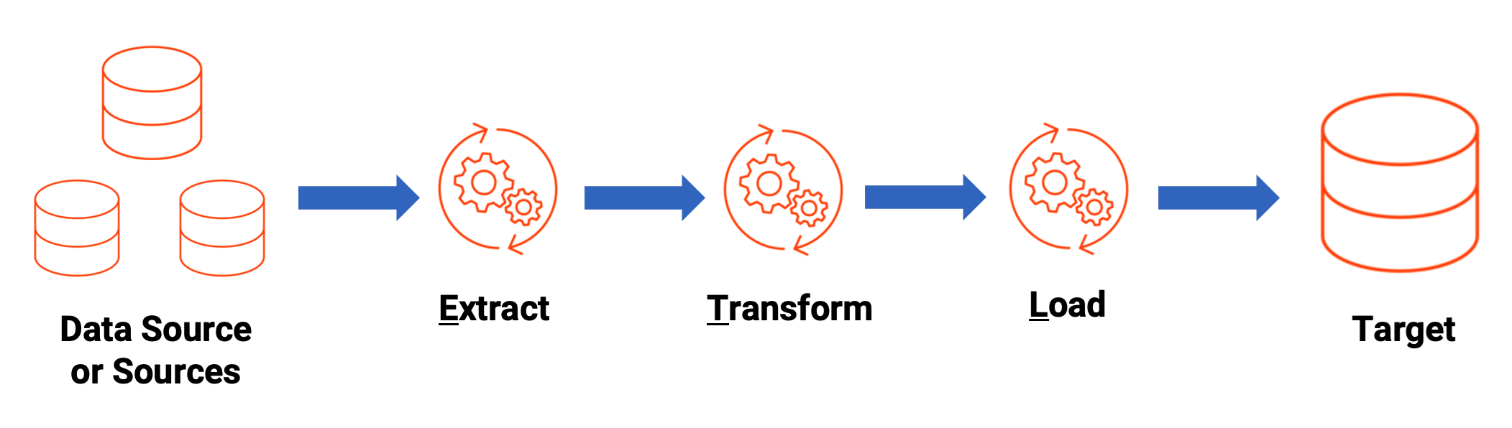
ETL Pipeline Overview
Extract
Transform
Load
Data sources:
Polygon.io
Data Cleaning
Adding Metrics
Star Schema
Load Data
SQL Server

Slide 6
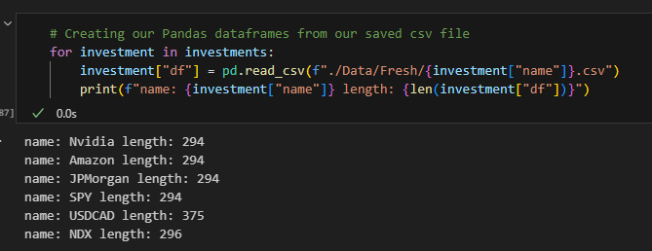
Extracting Data
Polygon API
Requests
Save response to CSV
Pandas
Load each response into separate data frame object

Slide 7
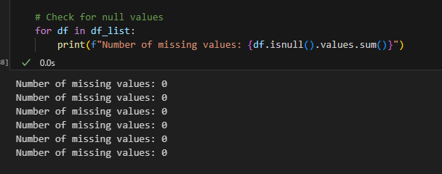

Transform – Cleaning
Cleaning up bad data
Check for null values
Remove duplicate rows

Slide 8
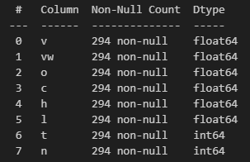
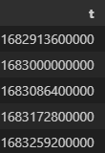
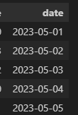
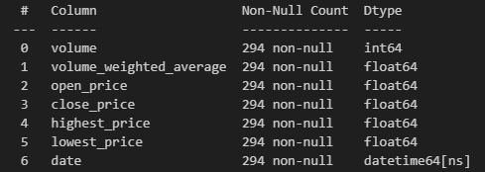
Transform – Quality
Ensuring high quality data
Renaming columns
Drop unneeded columns
Ensure correct data types
Convert timestamp

Slide 9
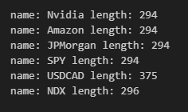
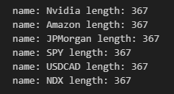
Transform – Missing Data
Adding in missing data
More days covered in some investments
Inconsistent data issues
Create dates range
Forward fill
Dropped extra days

Slide 10
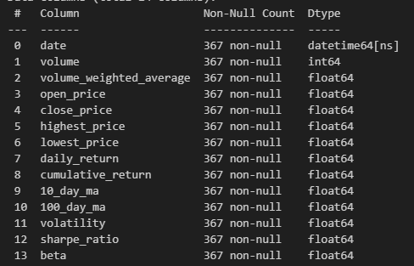
Transform – Aggregations
Adding in extra metrics
Daily/Cumulative Returns
10/100 Day Moving Average
Volatility
Sharpe Ratio
Beta

Slide 11
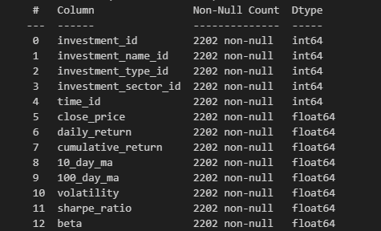
Transform – Star Schema
Fact Table
Dimension Tables
Investment Type
Stock, ETF, Forex, Index
Name
Sector
Tech, Finance, Broad Market
Time

Slide 12
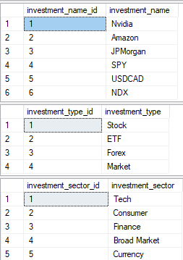
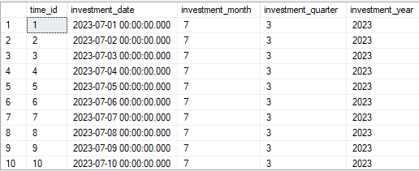
Load – SQL Server
Saving fact and dimension table as CSV
Create database and tables
Bulk insert csv file into tables
Ready to query and analyze

Slide 13
Portfolio Tracking Overview
Use Queries from SQL to select a time frame for analysis
Track portfolio performance
Visualize individual investments with Seaborn
Invest additional money based on analysis

Slide 14
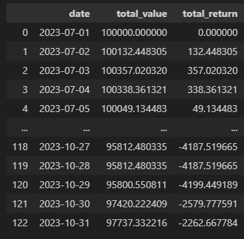
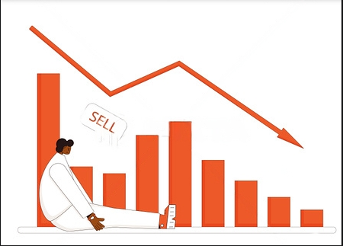
Portfolio Performance July 2023 – October 2023

Slide 15
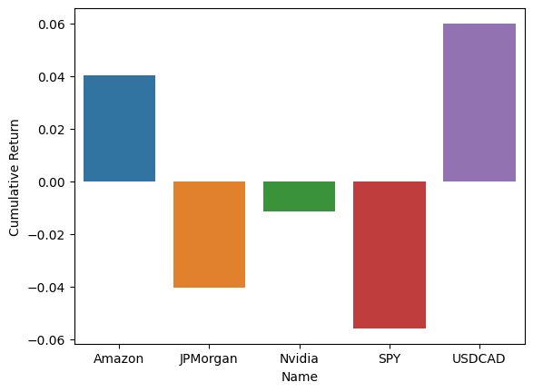
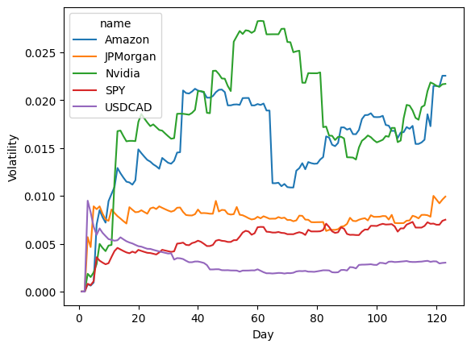
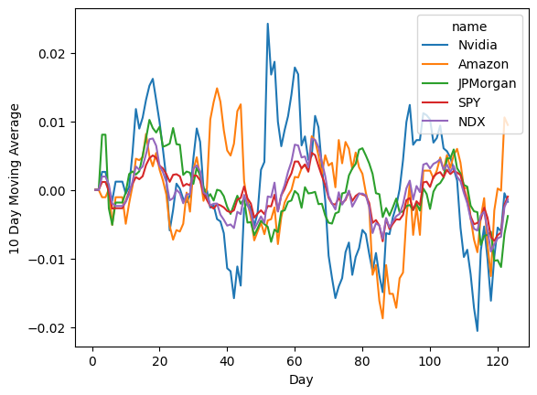
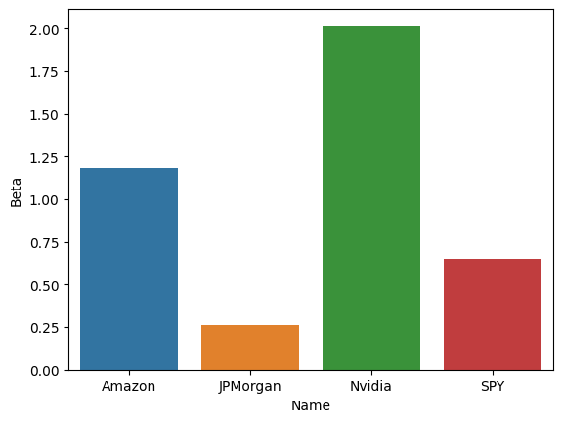
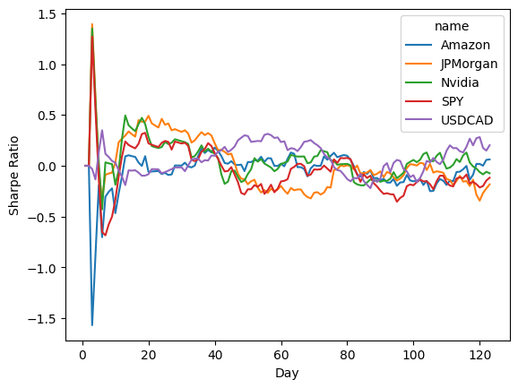
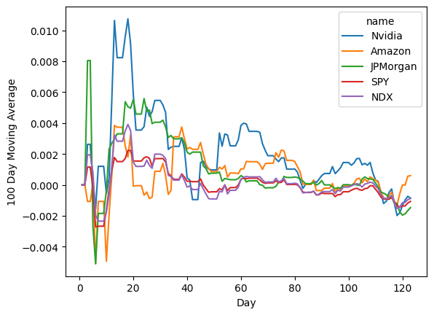
Investments Dashboard July 2023 – October 2023

Slide 16
Analyze Investments July 2023 – October 2023

Slide 17
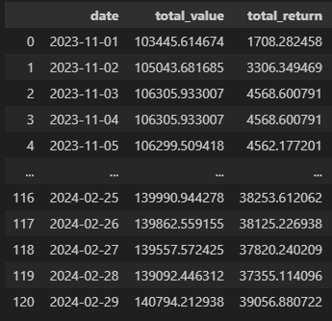

Portfolio Performance Nov 2023 – Feb 2024

Slide 18
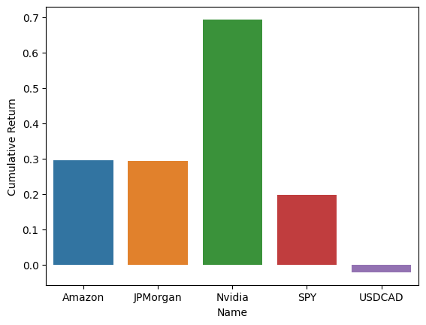
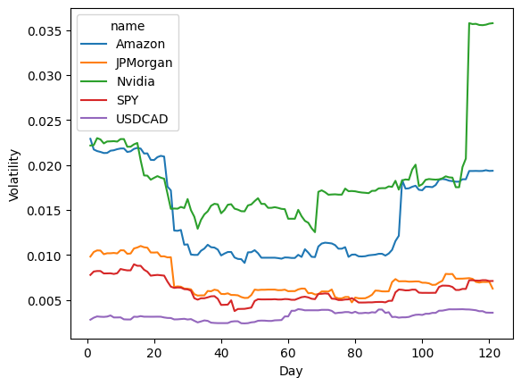
Analyze Investments July 2023 – October 2023

Slide 19
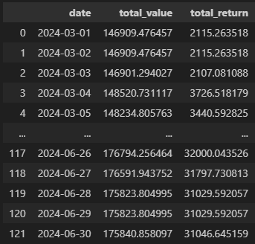
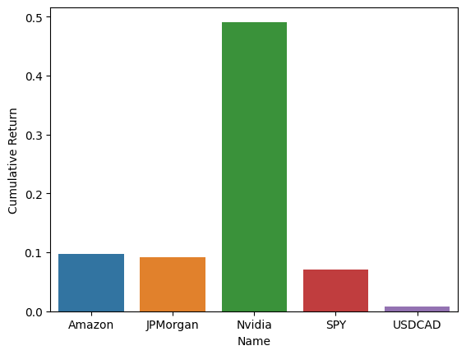
Analyze Performance March 2024 – June 2024

Slide 20
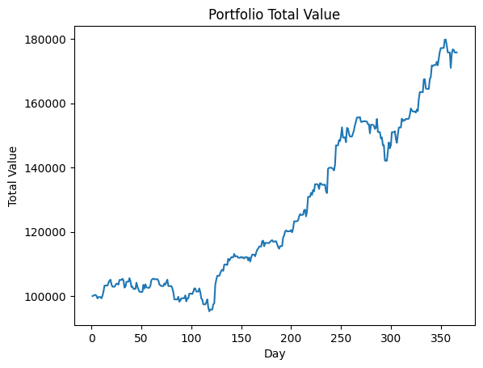
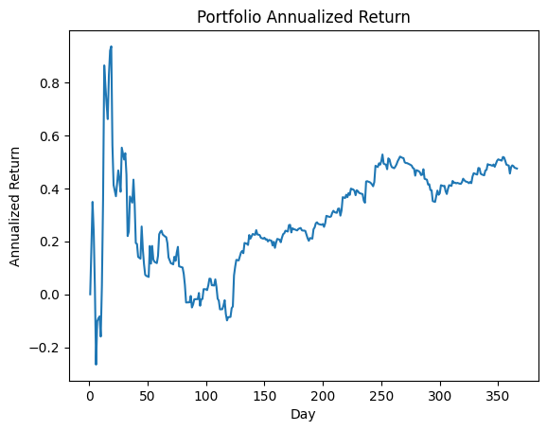
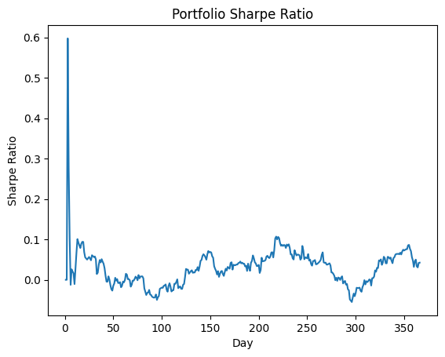
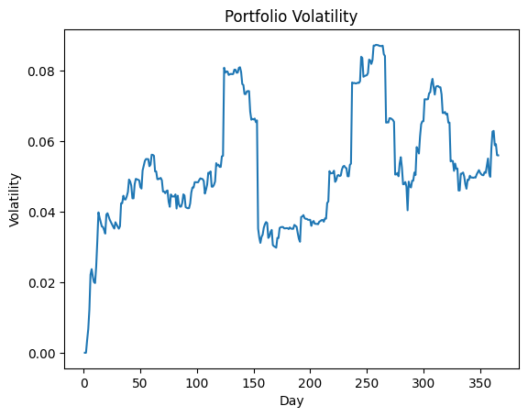
Overall Portfolio Performance Dashboard

Slide 21
Thank you!
Questions?

